Slide 1
Microsoft Productivity Apps
Apps for today and tomorrow

Slide 2
Goals and Objectives
  Introduction to Microsoft productivity Apps
  Definition of Productivity Apps
  Video
  Descriptions of specific Microsoft productivity apps
  Importance of Microsoft productivity Apps

Slide 3
Introduction
Employee productivity is the measure of the efficiency of a particular worker or team of workers. These software serve to increase the efficiency of this workers by facilitating their work.
These are Microsoft apps that have been designed at the Microsoft garage that enable mobile users to get the same Microsoft services that they get in their computers.
Productivity apps are software devoted to making our work easier and our live more productive. This apps help one to do his personal job or task faster, efficiently and more cheaply

Slide 4

Video 1
Notes:
link
https://support.office.com/en-us/article/Get-started-at-Office-com-91a4ec74-67fe-4a84-a268-f6bdf3da1804

Slide 5
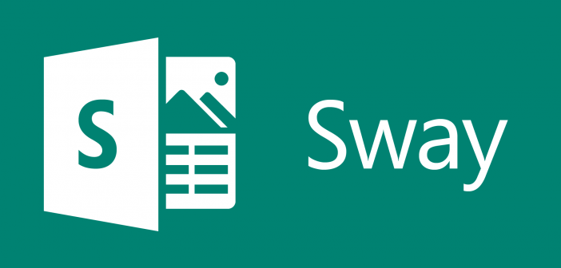
Millennial and technology
The list of Microsoft productivity apps include:
Microsoft sway
  It is a presentation program.
  The app is entirely online.
  It allows one to create documentation, newsletters, and presentation
Notes:
It was released in Aug. 2015
They are accessible using apps for windows iOS, Windows 10, office online/office 365, iPad and iPhone.

Slide 6
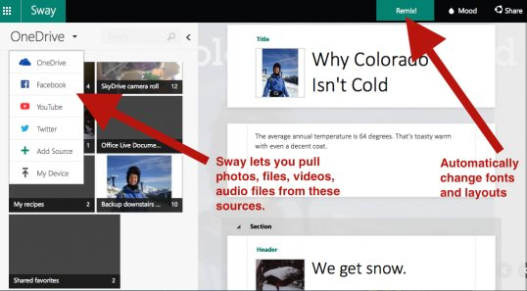
The app allows users with Microsoft accounts to combine media and text. This enables them to come up with presentable websites.
It allows users to pull content from the internet or the device in use.
They are stored on Microsoft servers.
They are linked to a user’s Microsoft account.
Notes:
Presentations are viewed, edited and created in one's browser or accessible via a free mobile app.

Slide 7
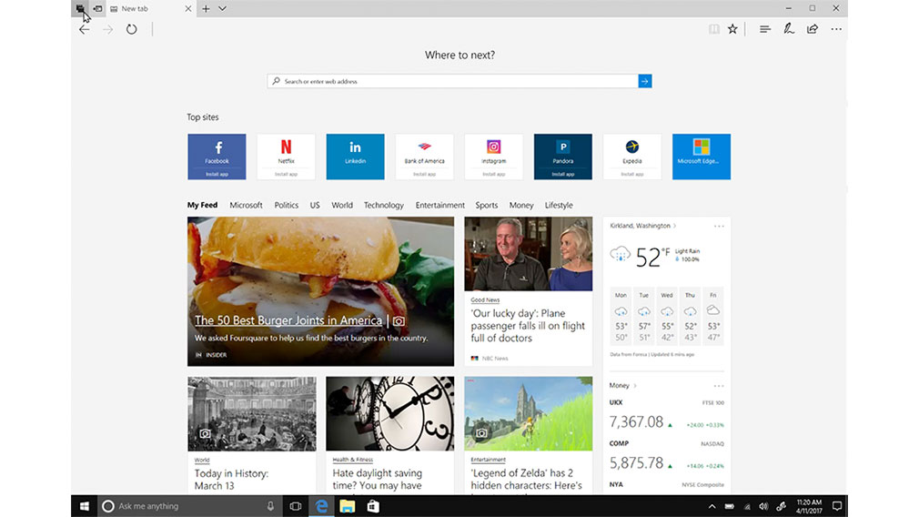
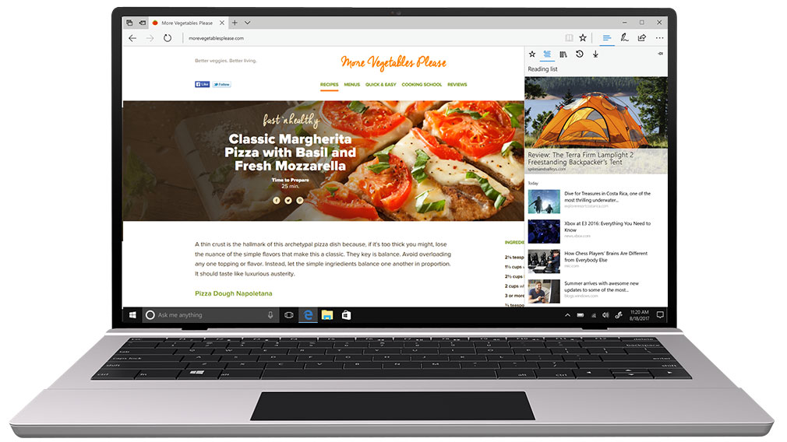
Microsoft Edge
This this is a Microsoft web browser used for productive web experiences.
Microsoft edge
It is included in Windows 10 mobile, Xbox One and Windows 10 thereby replacing Microsoft explorer, as the default browser.
Notes:
It integrates with Cortana digital assistant and Microsoft online platforms.

Slide 8
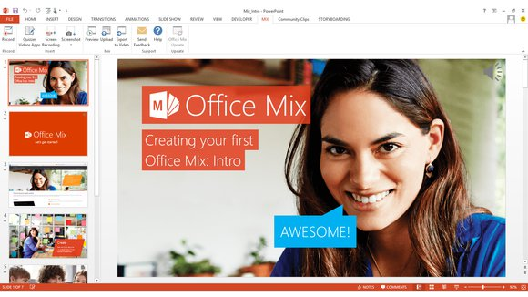
Microsoft Mix
  This is a free extension to PowerPoint that makes it easy for a user to turn PowerPoint presentations into interactive online lessons and share with colleagues in one note, on the web or in a learning management system.

Slide 9
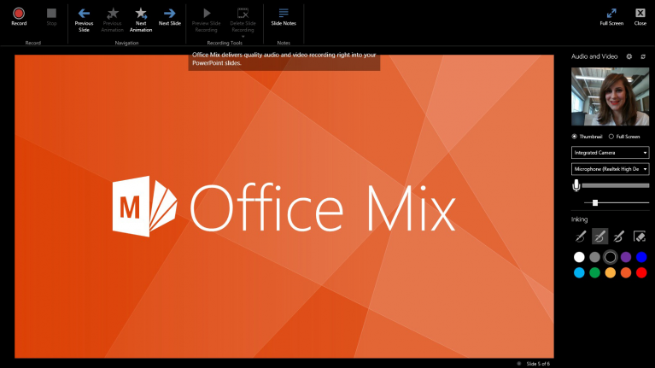
Microsoft Mix
It enables one to add.
  Video and audio narration
  The real-time digital thinking
  The screen recording that shows actions a user takes on their computer
  Polls and quizzes
  Videos, simulation, and live web pages.
All this is carried out in a PowerPoint.
The users can modify, view, download and delete existing content.
Notes:
To publish it, one uploads it to the web and can decide who can view it.
The app allows the mix owner to get information about who watches your mix, the duration of time they have spent on each slide or poll question.
The data can be exported to Microsoft Excel for analysis.
Microsoft is turning it into part of PowerPoint officially on May 1, 2018.

Slide 10
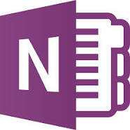
Microsoft OneNote
The notes in OneNote can be shared with other users via a network or internet.
This is a digital notebook
It is a computer program for multi-user collaboration and free-form information gathering.
Notes:
The app gathers user’s notes, drawings (typed or handwritten), audio commentaries and screen clipping.

Slide 11
It is available as part of:
    Windows 10
    Microsoft office
It is a free stand-alone program in the following windows:
      Windows phone
      iOS
      Android
      MacOS
      Windows 10, 8.1 and 10 mobile
      HoloLens
      Windows RT
A web-based version is available as part of:
    Office Online
    OneDrive
Notes:
The app enables users to enter typed text using keyboards, insert pictures and create tables.
The program saves data automatically as a user works
It saves the information in sections of pages within a notebook. The notebook allows one to organize, share and possibly collect unpublished materials unlike wikis and word processors.
The program commonly runs on desktop PCs or laptops.
It can also be used in pen-enabled tablets.

Slide 12
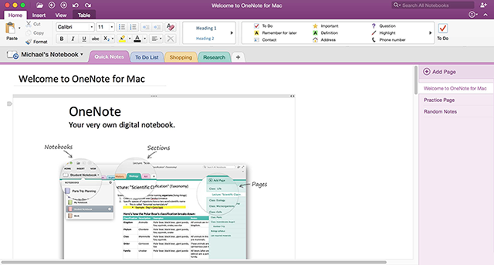
OneNote
In March 2014, the one-note cloud service API was released by Microsoft.
The new OneNote feature that is currently available to OneNote API service user are:
  Email to OneNote
  OneNote Clipper.

Slide 13

Video 2

Slide 14
OneNote
OneNote allows a user to:
  Record audio or type notes in one’s computer
  Write ideas or sketch on one's tablet
  Add pictures using one's phone
  Locate notes instantly
  Move note freely around the page
  Organize page into sections
  Keep one's sections in one or more notebooks
  Switch devices but still pick up where one had left before the change.
  Share notebooks with others.

Slide 15
Importance of Microsoft productivity apps
These apps make people to feel like that they are utilizing their day time the well by squeezing more into each day.
Office time management apps are relatively more complicated than personal ones due to the need to accommodate different time different types of data recording.
These apps let one to monitor their progress based on their set objectives and restate their plans based on the lessons they have learns and their plans.
Notes:
Office apps also separate personal from professional tasks and allow employees to report only work related data to avoid breach of privacy or other legal grey areas.
A though research around these apps is lacking. The app help an employee on focus on what he wants to achieve, apart from keeping track of time.
This has led to a die-hard customer base from individuals that use these app.

Slide 16
References
Azfar, A., Choo, K. K. R., & Liu, L. (2017). Forensic taxonomy of android productivity apps. Multimedia Tools and Applications, 76(3), 3313-3341.
Carey, P., DesJardins, C., Shaffer, A., Shellman, M., & Vodnik, S. (2016). New Perspectives Microsoft Office 365 & Office 2016: Introductory, Loose-leaf Version.
Mark, G., Iqbal, S., & Czerwinski, M. (2017, September). How blocking distractions affects workplace focus and productivity. In Proceedings of the 2017 ACM International Joint Conference on Pervasive and Ubiquitous Computing and Proceedings of the 2017 ACM International Symposium on Wearable Computers (pp. 928-934). ACM.
Parsons, J. J., Beskeen, D. W., Cram, C. M., Duffy, J., & Friedrichsen, L. (2016). Bundle: Illustrated Computer Concepts and Microsoft Office 365 & Office 2016+ LMS Integrated SAM 365 & 2016 Assessments, Trainings, and Projects with 1 MindTap Reader Printed Access Card. Cengage Learning.

